Slide 1
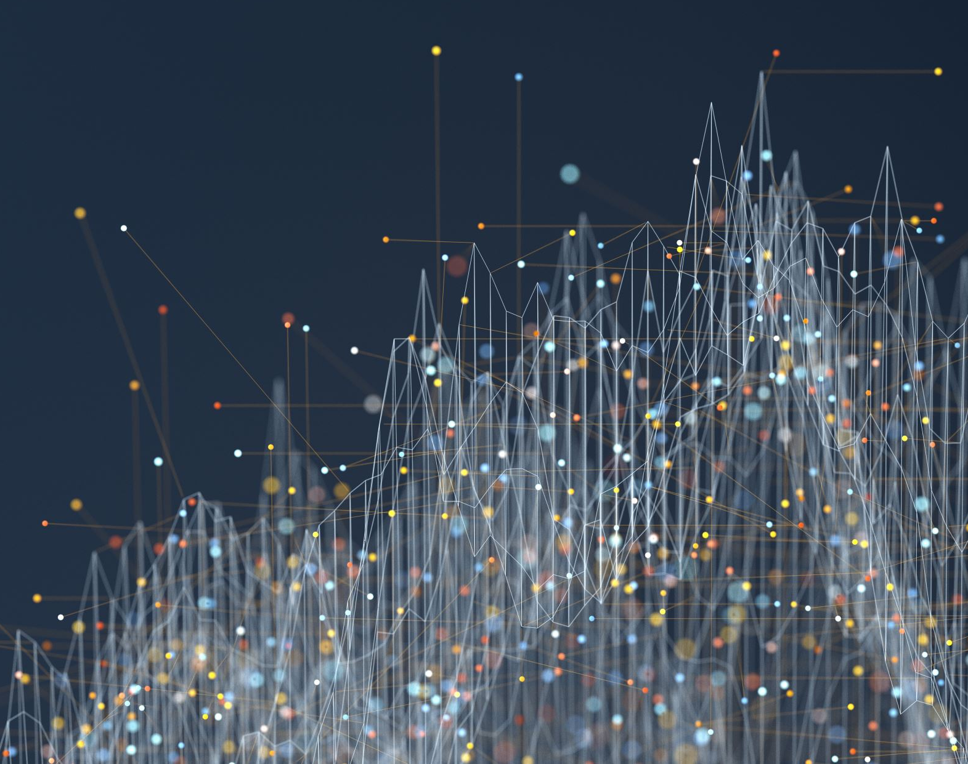
AI/ML Fundamentals: Introduction and Market Trends
Jan. 2025

Slide 2
AI: definition, history and evolution
Intro
Model
Data
Compute
“Artificial intelligence (AI), in its broadest sense, is intelligence exhibited by machines, particularly computer systems.”
Source: Artificial intelligence - Wikipedia
AI Development Highlights (2000- Jan 2025)
2000-2009: Foundations
Roomba® launched as an autonomous vacuum (2002).
ImageNet established as a benchmark for image recognition research.
2024: More Applications
Google®’s Gemini® 1.5 and OpenAI®’s Sora® debuted advanced AI systems.
Apple® launched "Apple Intelligence," integrating AI into Siri® and iPhones®.
GPT-o1® applied inference thinking into the model
AlphaFold® won the Nobel Prize in Chemistry for revolutionizing protein research.
2010-2019: Deep Learning Era
AlexNet transformed image recognition.
DeepMind®’s AlphaGo defeated world champions in Go
AlphaFold® predicted protein structures
2025: Cost-efficient, Open-Source, and Beyond
Deepseek® series with new RL process and low-cost training.
2020-2023: AI Revolution
GPT-3® and ChatGPT® advanced natural language understanding.
AlphaFold® 2 set new benchmarks in protein prediction.
Governments and organizations began regulating AI with forums and safety summits.
Source: Timeline of artificial intelligence - Wikipedia

Slide 3
Terminologies
Intro
Model
Data
Compute
General Machine Intelligence
(Rule based, Symbolic, etc.)
Artificial Intelligence
Learn and adapt
(Linear regression, etc.)
Machine Learning
Deep Learning
Neural Network based
(CNN, etc.)
Generative AI
Generate new content
(Large language model, stable diffusion, etc.)

Slide 4
Intro
Model
Data
Compute
Terminologies
Artificial Intelligence
Machine Learning
Generative AI
Foundation
Models
Large Language
Models (LLM)
Generative Pretrained Transformer
Large Language Model Meta® AI
GPT
LLaMA
Custom Models

Slide 5
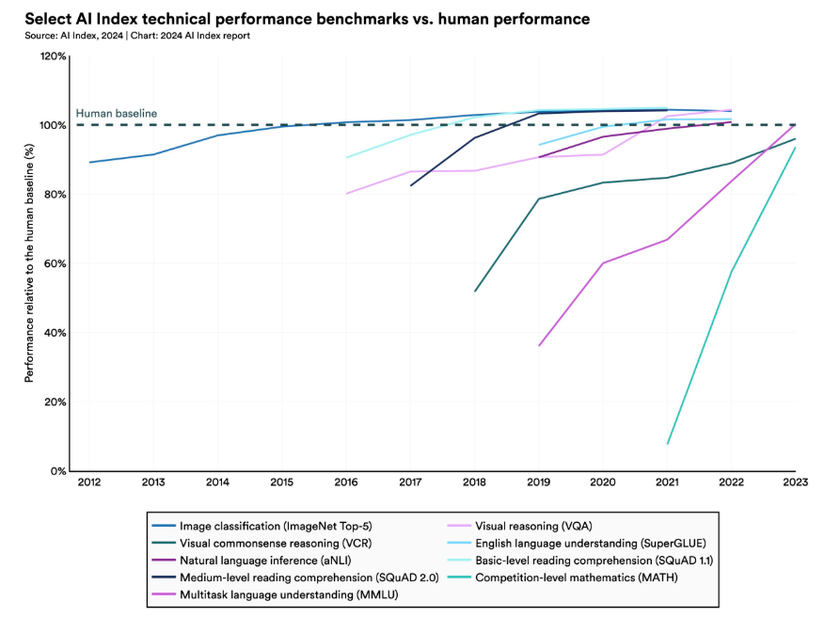
Human Performance as a Benchmark
Intro
Model
Data
Compute
The machine is beating human performance in more and more tasks.
Source: AI Index Report 2024 – Artificial Intelligence Index, Stanford AI index

Slide 6
Why Gen AI?
Intro
Model
Data
Compute
“Generative AI has the potential to change the world in ways that we can’t even imagine. It has the power to create new ideas, products, and services that will make our lives easier, more productive, and more creative. It also has the potential to solve some of the world’s biggest problems, such as climate change, poverty, and disease.” – Bill Gates
Source: Forbes
$62.72
Billion
CAGR
41.53%
Source: Generative AI - Worldwide | Statista Market Forecast
2025 expectation
2025-2030 expectation

Slide 7
Top 5 Challenges for IT Leaders in 2025
Data
Compute
Intro
Model
Unlock the Power of Data with New Applications
Data is the new energy of the economy. Whoever can first drill value out of the data field will gain advantage in business competition.
1
Build Intelligence Using ML and Generative AI
In 2025, ML and gen AI become the priority in enterprises worldwide. The power of ML may greatly affect the world and businesses this year through providing new insights.
2
Enforce Data Governance and Data Quality
Data governance not only ensures the compliance but also need to be combined with data quality control to ensure the information is accurate, on-time, and complete.
3
Ensure Data Resilience and Security
Data resilience and security will be facing new challenges in the new year. Ransomwares and disasters are in the trend of increasing.
4
Improve Cost Efficiency
The amount of data is growing in a rapid pace. We need innovations in infrastructure to control the budget.
5

Slide 8
Importance of Data Platform and Gen AI
Compute
Intro
Model
Data
62.3% of leaders consider investments in Gen AI as a top priority
Source: WaveStone 2024 DATA AND ANALYTICS LEADERSHIP ANNUAL EXECUTIVE SURVEY
DataAI-ExecutiveLeadershipSurveyFinalAsset.pdf (wavestone.com)

Slide 9
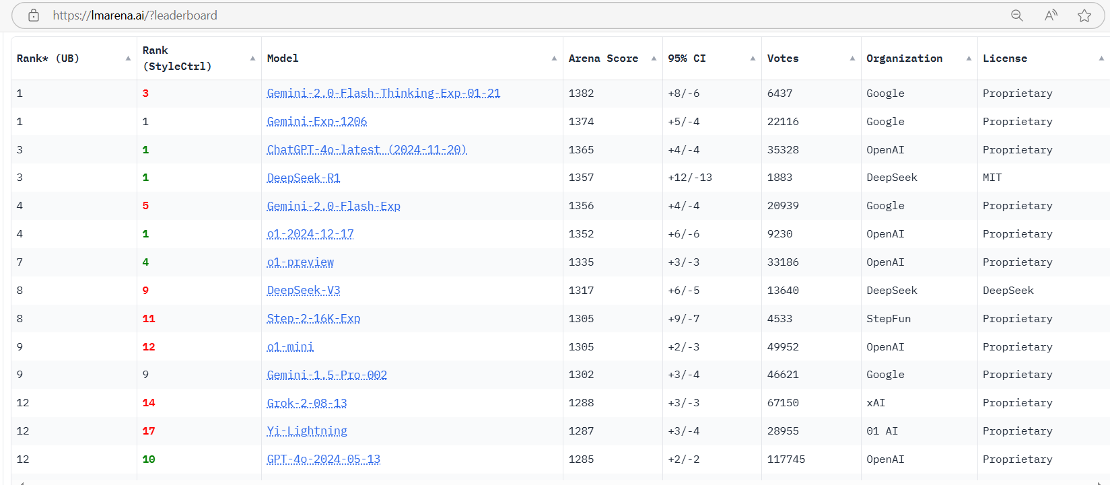
Model Arena Ranking (as of Jan 27, 2025)
Intro
Model
Data
Compute

Slide 10

Intro
Model
Data
Compute
More varieties
Beat common human performance in
Math/Coding
Painting
… more
Artificial General Intelligence (AGI)
Algorithms
(e.g., Models, NN, Transformers, etc.)
???
Book by Nick Bostrom, 2014
Core Enablers of AI
The standards are still vague
Data
(e.g., Text, Video, Images, etc.
Computation
(e.g., accelerators, GPUs, etc.)
Data widely exist on Internet and in enterprises
Document
Data lake
Simulation and synthetic data
Multi-modal
Faster GPUs every year
More varieties of accelerators

Slide 11
AI Ethics
Intro
Model
Data
Compute
Fairness:
Make AI treat everyone equally.
Transparency:
Ensure people understand how AI works.
Responsibility:
Hold someone accountable for AI decisions.
Privacy:
Protect personal data and respect user rights.
Human alignment:
Ensure AI follows human values.
Regulations are set by different government and organizations worldwide..
The word AI may mean different things in different places and context.
Regulations are used to protect us from current and future threats, including superintelligence.
Ethics are evolving with many debates.
AI Watch: Global regulatory tracker | White & Case LLP

Slide 12
Task Examples
Intro
Model
Data
Compute
Traditional task examples:
Classification: Assign labels (e.g., spam detection).
Regression: Predict continuous values (e.g., price prediction).
Clustering: Group similar data (e.g., customer segmentation).
Anomaly Detection: Identify unusual patterns (e.g., fraud detection).
Recommendation Systems: Suggest items (e.g., Music recommendations).
Time Series Forecasting: Predict sequential data (e.g., sales forecasting).
Computer Vision: Tasks like object detection or face recognition.
LLM-based task examples:
Text Generation: Create coherent, context-aware text.
Question Answering (QA): Provide accurate answers to queries.
Conversational AI: Enable human-like dialogue (e.g., chatbots) for customer service.
Code Generation: Write or debug code.
Sentiment Analysis: Extract sentiment from nuanced text.
Multimodal Tasks: Process text, images, or audio together.
Creative Applications: Assist with storytelling and content creation.
Personalization: Adapt solutions to user preferences.
Healthcare
Finance
Manufacturing
Education
Retail
and More
Vertical Industries

Slide 13
Training
Intro
Model
Data
Compute
Supervised
Learning
Unsupervised Learning
Semi-supervised Learning
Reinforcement Learning
Trains on labeled data to map inputs to outputs.
Used for classification (e.g., spam detection) and regression (e.g., price prediction).
Minimizes prediction errors using a loss function.
Common algorithms: linear regression, decision trees, neural networks.
Works with unlabeled data to identify patterns or structures.
Used for clustering, anomaly detection, and dimensionality reduction.
Algorithms: k-means, hierarchical clustering, PCA.
Evaluated using domain expertise or indirect metrics.
Combines small labeled data with large unlabeled data.
Enhances generalization by leveraging both data types.
Applied in NLP and fields where labeled data is costly.
Methods: self-training and iterative labeling.
Agents learn by interacting with an environment and receiving rewards/penalties.
Focuses on optimizing cumulative rewards.
Applied in games, robotics, and autonomous systems.
Key algorithms: Q-learning, DQN, policy gradients.

Slide 14
Training and Serving Pipeline
Intro
Model
Data
Compute
1. Data Collection: Gather relevant and high-quality data to train your model or system.
2. Data Preparation: Clean, preprocess, and transform the data into a usable format.
3. Model Training: Use the prepared data to train the model, optimizing it over iterations.
4. Evaluation: Test the model on validation data to measure performance and identify issues.
5. Deployment: Integrate the trained model into real-world applications or systems.
6. Monitoring: Continuously monitor the model's performance and update as needed.
Training Goal: Generate or finetune the model.
Serving (aka Inferencing or deployment) Goal: Use the model to finish the task in hand.

Slide 15
Transfer learning
Intro
Model
Data
Compute
Utilizes knowledge from a pre-trained model to solve a new but related task.
Reduces training time and improves performance with limited data.
Common in computer vision (e.g., using ImageNet models) and NLP (e.g., BERT, GPT).
Fine-tuning or feature extraction adapts the pre-trained model to the new task.
Effective when tasks share similarities, such as domain or data structure.
Data
Source
Model
Training
a. Obtaining a pretrained model via training
Zero-shot
(no examples)
Model
Prompt Engineering
b. Using it with prompt engineering
Few-shot
(few examples)
Model
FT’ed
Model
Fine tuning
More
Data
c. Finetuning the model for downstream tasks

Slide 16
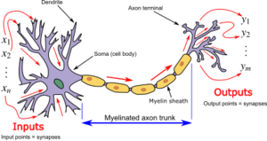
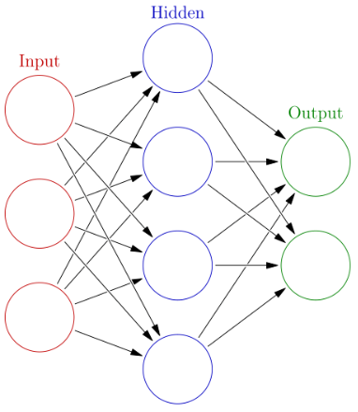
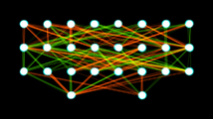
Neural Network
Intro
Model
Data
Compute
a. Real neurons and neural network
3 Neurons as input
2 Neurons as output
8 Neurons as input
b. Artificial Neural Network, a single layer ANN
2x8 Neurons (aka nodes) in the 2 hidden layers
4 Neurons (aka nodes) in the hidden layer
2 Neurons as output
c. A 2-layer feedforward ANN
Source: Neural network (machine learning) - Wikipedia
Simulate real biological neural networks with math

Slide 17
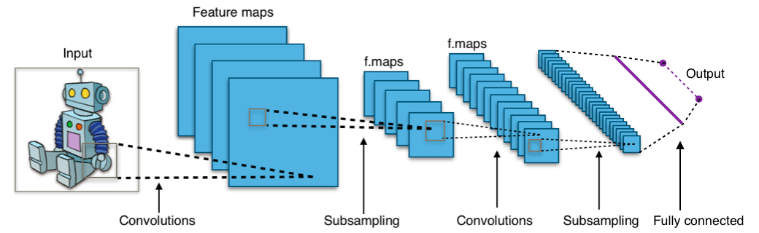
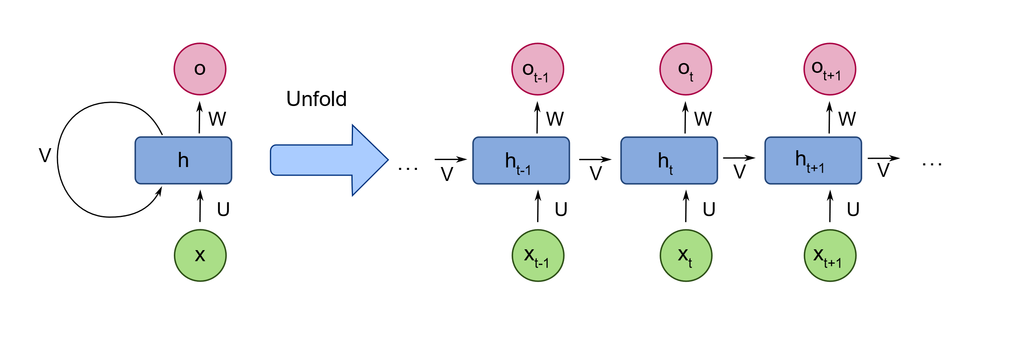
NN Architectures
Intro
Model
Data
Compute
Standard artificial neural network (ANN): Standard deep ANN are neural networks with multiple hidden layers with interconnected neurons, that communicate through synapses.
Convolutional neural network (CNN): CNNs are a type of neural network that are well-suited for image classification tasks. CNNs are composed of a series of convolutional layers, which extract features from images, and pooling layers, which down sample the feature maps.
Recurrent neural network (RNN): RNNs are deep neural networks that has the ability to store information from previous computations and passes it forward so as to work upon this data in a sequential manner. LSTM (Long Short-term Memory) is a sub-category of RNN
Transformer and beyond (see next section)
CNN mimics how humans recognize patterns, like identifying shapes and objects in pictures, by breaking the image into small pieces and analyzing them. Convolutions are filters capturing features such as an edges, corners, or textures.
Source: Convolutional neural network - Wikipedia
RNN was designed to process a sequence of data. At each step, RNN combines the new input with the previous state, which is often referred to as “memory”.
Source: Recurrent neural network - Wikipedia

Slide 18
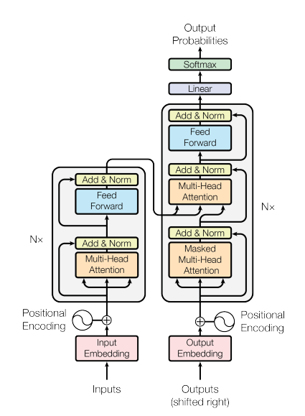
Transformer
Intro
Model
Data
Compute
Foundation for Pretrained Models: Powers modern AI advancements in text, vision, and science.
The models for NLP tasks are called Large Language Models (LLM).
The models for vision tasks are called large vision models.
The models for a mixed range of tasks are called multi-modal models.
When the scale of transformers is large (into the billions), the models show the capability of reasoning besides memorizing.
It is called emergent behavior.
The performance is better if the prompt is explaining the thinking steps. It is referred to as Chain of Thought or CoT (Wei et al. 2022, [2201.11903] Chain-of-Thought Prompting Elicits Reasoning in Large Language Models)
Today many of the models can generate CoT during the inference time.
Decoder
Part (most gen AI models are decoder only today)
Encoder
Part
This is called a transformer layer or block
For example, the LLaMA-7b model
has 32 transformer layers and it is decoder only. A larger model has more layers.
Larger models often have a better performance than smaller models today. For example, a 70b model likely has a better benchmark score than a 7b model.
Source: Vaswani et al. 2017 [1706.03762] Attention Is All You Need

Slide 19
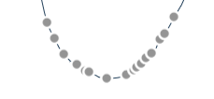
Learning Process
Intro
Model
Data
Compute
Gradient descent will try different values (grey points) to lower the value of the loss function.
Backpropagation
An algorithm that calculates the error between the network's predicted output and the actual target, then propagates this error backwards through the network, adjusting the weights and biases of each neuron proportionally to minimize the error.
Loss Function
A loss function measures the difference between predicted and actual values. The goal is to minimize this difference, improving model accuracy.
Gradient Descent
Gradient Descent is an optimization algorithm used to minimize the loss function. It works by iteratively adjusting model parameters based on the gradients, with the step size controlled by the learning rate.
Loss function
of variable weight
Initial
value
Final
value
Source: Backpropagation - Wikipedia
Weight value
Goal: Find the weight point to minimize the loss function.

Slide 20
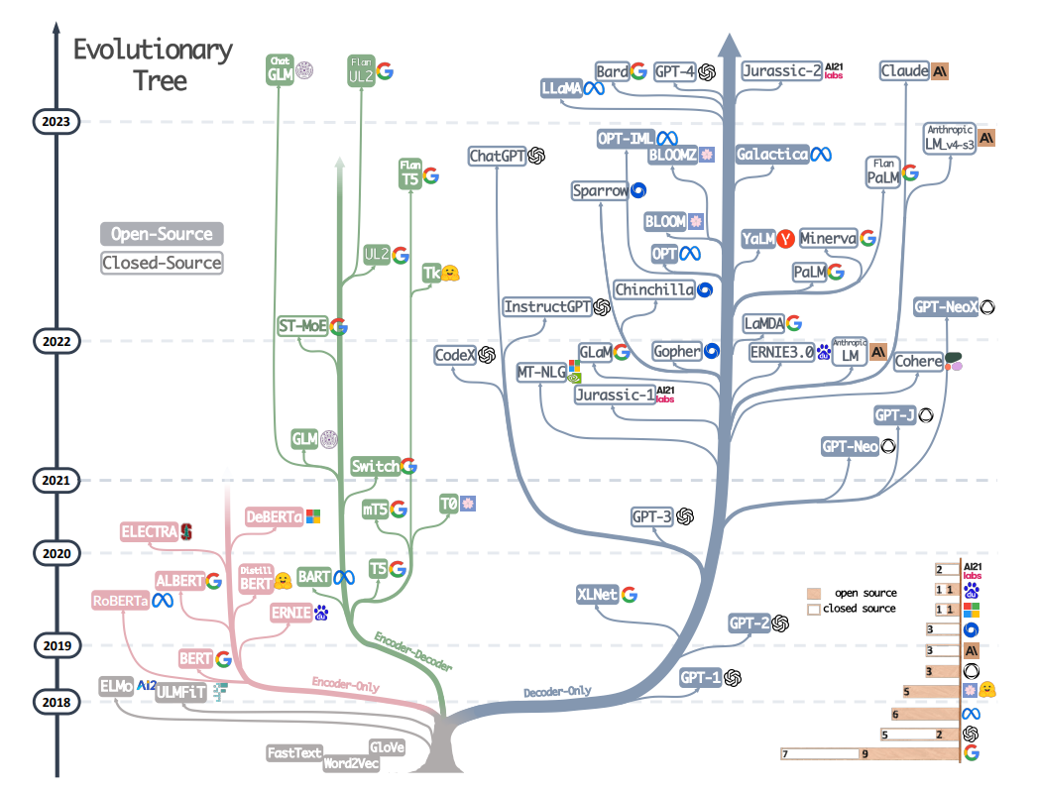
LLM Evolution History
Data
Compute
Intro
Model
Source: Yang et al., 2023, [2304.13712] Harnessing the Power of LLMs in Practice: A Survey on ChatGPT and Beyond

Slide 21
Data Needs Preparation
Intro
Model
Data
Compute
“Garbage in, garbage out”
Data needs preparation to be used.
Cleaning and possibly labeling
Reformatting
Refreshing knowledge
Data
Acquisition
Data
Cleaning and
preparation
Data
Repository
Data Governance
Data
Transfor-
mation
Data Analysis
Data Platform with pipeline observability

Slide 22
Data Storage Needs
Intro
Model
Data
Compute
Data Pre-Processing
Multi-protocol access
High-speed search
Mix of large and small I/O
Mix of IO read and write
Model Evaluation
I/O Read Dominant
High bandwidth
Low latency
Data Archiving
Data lifecycle management
Low cost
Frequent access
Ingestion
Pre-processing
Training
Evaluation
Inferencing
/Serving
Archiving
Data Ingestion
Multi-protocol access
High parallelization
High bandwidth
Large capacity
Data Training
Large amount of read requests
High bandwidth
Low latency
Checkpoints
Model Inferencing
High parallelization
Low latency
Model repository and deployment

Slide 23
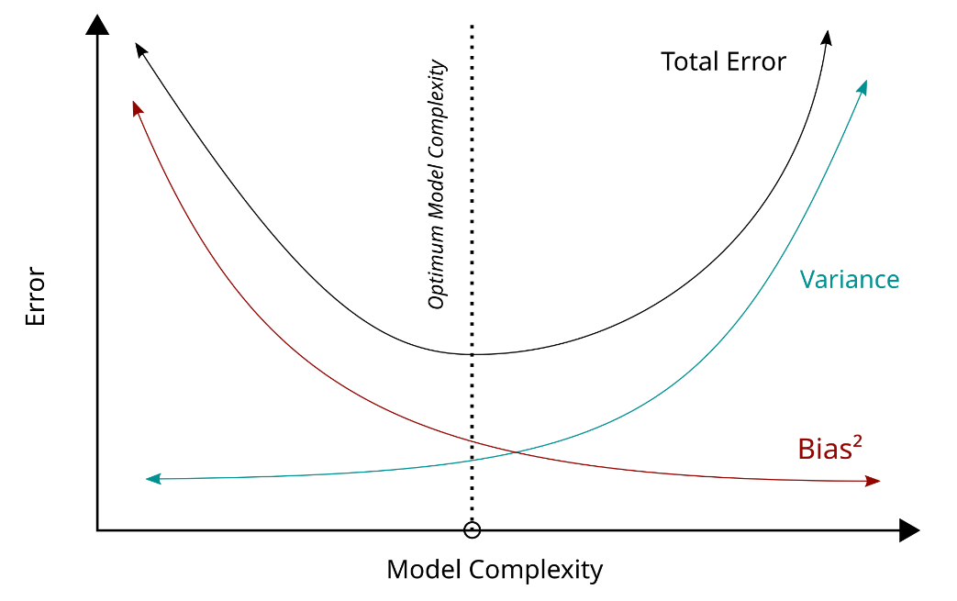
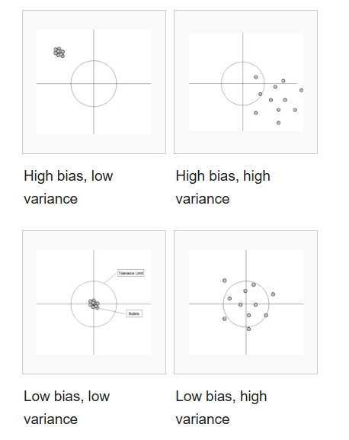
Bias-Variance Tradeoff
Intro
Model
Data
Compute
Train-test split, cross-validation
Don’t allow test data leak into the training data set
Bias: Overfitting vs underfitting
“The bias–variance tradeoff is a central problem in supervised learning.”
Source: Bias–variance tradeoff - Wikipedia

Slide 24
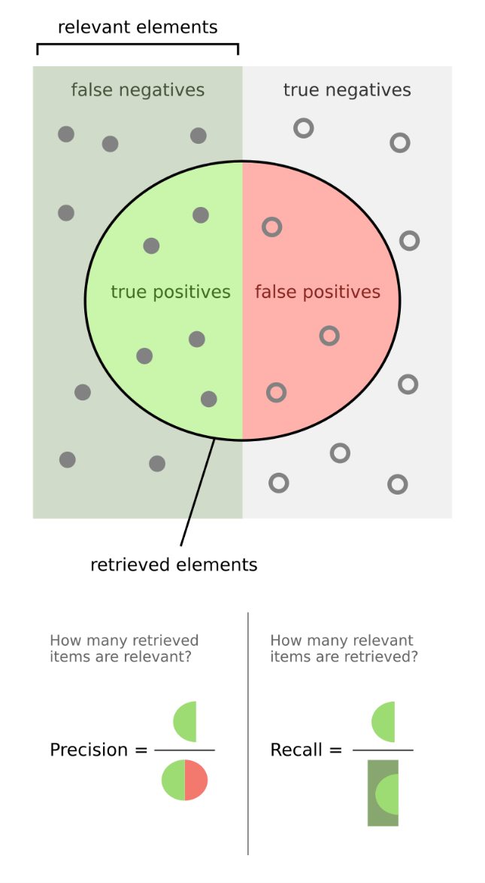
Performance Metrics
Intro
Model
Data
Compute
Classification (e.g., Spam Detection, Image Recognition)
Accuracy: How many predictions are correct.
Precision: How many predicted positives are actually correct.
Recall: How many actual positives were found.
F1-Score: A balance between precision and recall.
Performance metrics: quantify the quality of prediction made by ML models trained via data
Regression (e.g., Price Prediction, Stock Forecasting)
MAE: Average absolute error.
MSE: Penalizes larger errors more.
RMSE: Like MSE, but easier to interpret.
R²: How well the model explains the data.
NLP (e.g., Chatbots, Translation)
BLEU: Checks how close machine translations are to human ones.
ROUGE: Measures how well AI-generated summaries match real summaries.
Perplexity: Evaluates how well a model predicts text.
Source: Precision and recall - Wikipedia

Slide 25
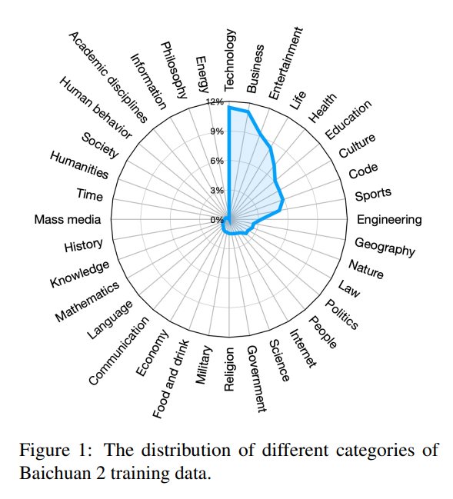
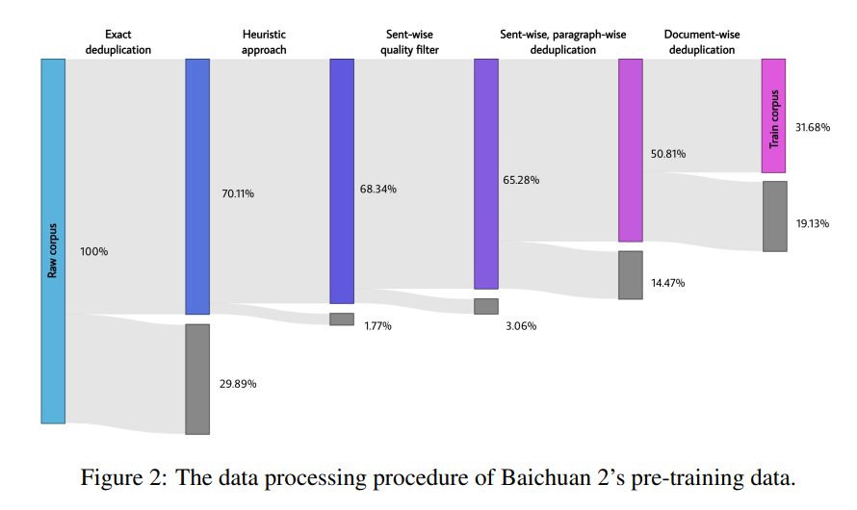
Gen AI dataset as an example
Intro
Model
Data
Compute
Each model has its domain knowledge.
The percentage of mix is unique.
Data needs to be pre-processed.
Only partial data is used for training
Source: Yang et al., 2023, [2309.10305] Baichuan 2: Open Large-scale Language Models

Slide 26
Data for Fine Tuning
Intro
Model
Data
Compute
Why Fine-Tuning Data?
Helps adapt pre-trained AI models to specific tasks or domains.
Improves model accuracy and relevance for specialized applications.
Supervised Fine Tuning (SFT) Reduces training time compared to training from scratch.
Characteristics of Good Fine-Tuning Data
High-Quality: Clean, well-labeled, and free of errors.
Domain-Specific: Matches the target application (e.g., medical, legal, finance).
Diverse: Covers a range of variations within the domain.
Balanced: Avoids bias and ensures fair representation.
Example Sources of Fine-Tuning Data
Existing Labeled Datasets: Open-source datasets (e.g., ImageNet, Wikipedia).
Domain-Specific Data: Medical records, legal documents, industry reports.
Synthetic Data: AI-generated data for filling gaps in real data.
User Feedback: Collecting real-world corrections and adjustments.
Model
Fine Tuned
Model
Fine tuning
FT Data
(e.g., Domain Data)

Slide 27
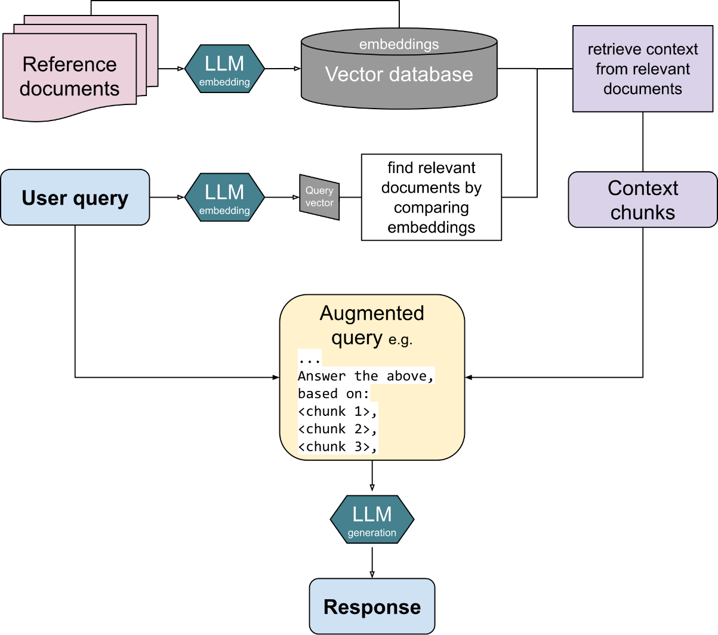
Retrieval Augmented Generation (RAG)
Intro
Model
Data
Compute
RAG process:
Alleviate the Hallucination problem introduced by LLM-based response.
The retriever encodes user-provided prompts and relevant documents into vectors, stores them in a vector database, and retrieves relevant context vectors based on the distance between the encoded prompt and documents.
The generator then combines the retrieved context with the original prompt to produce a response.
Advanced RAG:
Added more steps and ways to increase the accuracy of obtaining information.
For example, GraphRAG (Edge et al., 2024, [2404.16130] From Local to Global: A Graph RAG Approach to Query-Focused Summarization)
Source: Retrieval-augmented generation - Wikipedia

Slide 28
Vector Database
Intro
Model
Data
Compute
Boosted by the wide use of RAG
$3.04
Billion
CAGR
23.7%
Simplify data storage, organization, retrieval of complex data types: images, likes, sounds, text files, pattern data, map data, genomic information, etc.
An integral part of machine learning and for data in diverse domains, offer high performance and scalability.
Handle high-dimensional data and perform rapid similarity searches.
2025 expectation
2024-2029 expectation
Source: The business research company, Vector Database Market Report 2025 - Vector Database Industry Analysis And Overview
Data
Source
Vector DB
Question: Does Mary have a little lamb?
Chunking
Save
Query <0.9, 0.231,...>
Embedding
Model
Vectorizing
Indexing
<01,0.22,0.405,..>
<052,0.4,0.007,..>
…

Slide 29
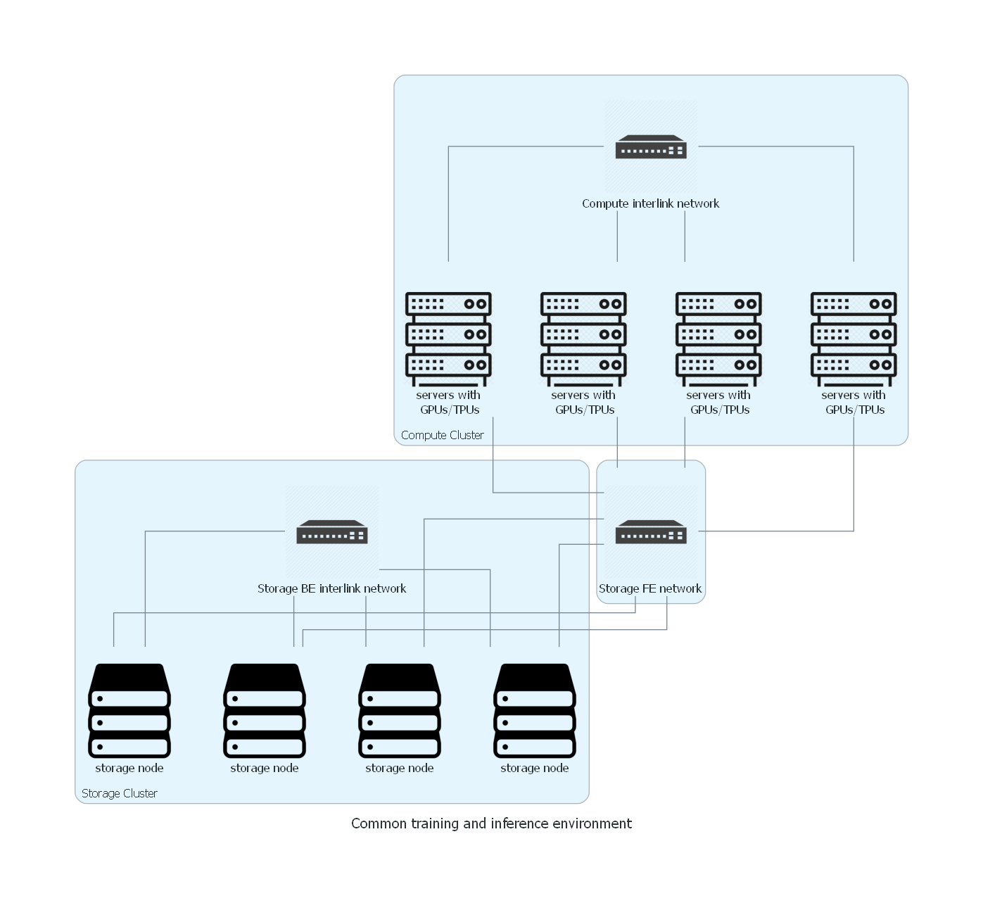
Ecosystem Overview
Intro
Model
Data
Compute
LangChain®, etc.
LLaMA®, etc.
Applications
DeepSpeed, vllm, etc.
Models
Training/Serving
PyTorch, etc.
DL libs
Kubernetes®, etc.
Orchestration
Vendor specific, e.g., Nvidia® CUDA, etc.
GPU driver
OS
Linux®, etc.
Hardware
Open Tech Stack of Gen AI

Slide 30
GPUs
Intro
Model
Data
Compute
Why GPUs Are Important for AI?
Parallel Processing: AI models perform billions of matrix multiplications, which GPUs handle efficiently.
Deep Learning Acceleration: Neural networks involve heavy computations that GPUs execute much faster than CPUs.
Memory Bandwidth: GPUs have high-speed memory (VRAM) to handle large AI datasets.
Support for AI Frameworks: Optimized for many ML libraries.
For large scale matrix operations, GPUs can be thousands of times faster than CPUs due to the large number of cores.
Feature | CPU | GPU
Cores | Few (4-64) | Thousands
Processing Type | Sequential | Parallel
AI Performance | Slow | Fast
Best for | General computing | Deep learning, AI, graphics

Slide 31
Scaling laws and more
Intro
Model
Data
Compute
The Scaling Law (Kaplan et al., 2020, [2001.08361] Scaling Laws for Neural Language Models) describes how the performance of AI models improves as we increase the amount of compute, model size, and training data.
It shows that larger models, when trained on more data with more compute, follow predictable improvements in loss and capability.
Chinchilla law (Hoffmann et al. 2022, [2203.15556] Training Compute-Optimal Large Language Models) emphasizes that for fixed budget, smaller model with more data can be more effective than bigger model with less data.
Computing is measured in FLOPs (Floating Point Operations per Second)
Or total GPU hours with a certain model
✅ Larger Models Keep Getting Better (So far still is). ✅ More Data is as Important as Model Size (Chinchilla: 4x data = 2x model size). ✅ Training Efficiency Matters (Scaling laws help optimize compute costs). ✅ Transfer to Multimodal AI (Text, images, video, and code models scale similarly).

Slide 32
Training/Inference Tool Examples
Intro
Model
Data
Compute
Tool #1
Deepspeed®: It’s an open-source tool for training and inferencing. It was widely used worldwide.
Follow the link for more information:
Latest News - DeepSpeed
Tool #2
vLLM: It’s an open-source tool for inferencing. It evolved from a UC Berkeley project to a full-fledged open-source project.
Follow the link for more information:
Welcome to vLLM — vLLM

Slide 33
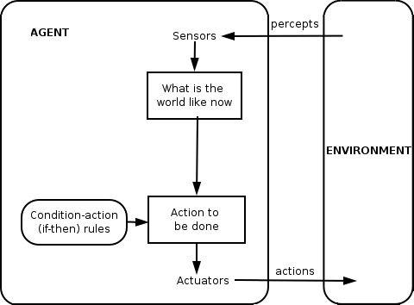
Agentic Workflow
Intro
Model
Data
Compute
“I think AI agentic workflows will drive massive AI progress this year — perhaps even more than the next generation of foundation models.”
-- Andrew Ng (2024 on X®)
What about 2025?
New paradigms of using models
New tools developed
Source: Intelligent agent - Wikipedia

Slide 34
Tools and Framework Examples
Intro
Model
Data
Compute
Frame #1
LangChain® provides not only the packages for using LLMs for different tasks, but also the packages called LangGraph® to build agents.
Follow the link for more information:
Introduction | 🦜️🔗 LangChain
Frame #3
Huggingface® is where you can find all kinds of information about LLM, including models, datasets, and different examples.
Follow the link for more information:
Hugging Face – The AI community building the future.
Frame #2
LlamaIndex® provides similar functionalities as LangChain® but focuses on efficient data retrieval for RAG.
Follow the link for more information:
LlamaIndex - Build Knowledge Assistants over your Enterprise Data

Slide 35
Enterprise Readiness
Intro
Model
Data
Compute
AI has been rapidly expended into production
=> Enterprises need to be ready
Open-source models are ready
=> On-prem deployment is ready for enterprises
Pretraining is converging, inferencing becomes more and more important
=> Enterprises need to invest into the right infrastructure
RAG provides ways to increase accuracy, consistency, and ROI
=> Enterprise need to build up advanced knowledge retrieval system
Agentic AI are developing, LLM is just part of the system
=> Enterprises need system thinking and investment

Slide 36

Thank you!
Comments
Q&A

